Slide 1
Research Intro: Formal Reasoning of Robustness
Changjian (CJ) Zhang

Slide 2
What is Robustness?
IEEE: Robustness is the ability of a software system to continue functioning correctly in the presence of invalid inputs or stressful environment.
Avizienis et al.: Robustness is a secondary attribute of dependability, i.e., dependability with respect to external faults.

Slide 3
Gaps in Existing Robustness Research
Testing vs. Measurement
Existing works focus mostly on testing a system is robust or not.
Evaluation vs. Improvement
Existing works pay less attention to improve robustness.
Implementation vs. Design
Most works target system implementation instead of robust system design.

Slide 4
Motivations
We need to build methodologies for software systems that can systematically and rigorously analyze, measure, and improve system robustness.

Slide 5



Robust-by-Design
Formal models are a great medium for representing software designs, enabling systematic and rigorous analysis.
Methods to systematically measure robustness.
Design
Robustness
Analysis
Developer, Designer,
Architect
Methods to systematically improve the robustness of a system design.
Robustify
Design

Slide 6
Robustness in a Formal View
Software systems are designed and implemented with respect to certain specifications.
A specification makes assumptions about the operating environment and claims guarantees on certain functionalities.
Robustness, a system should continue to provide the guaranteed functionalities under unexpected environment.

Slide 7
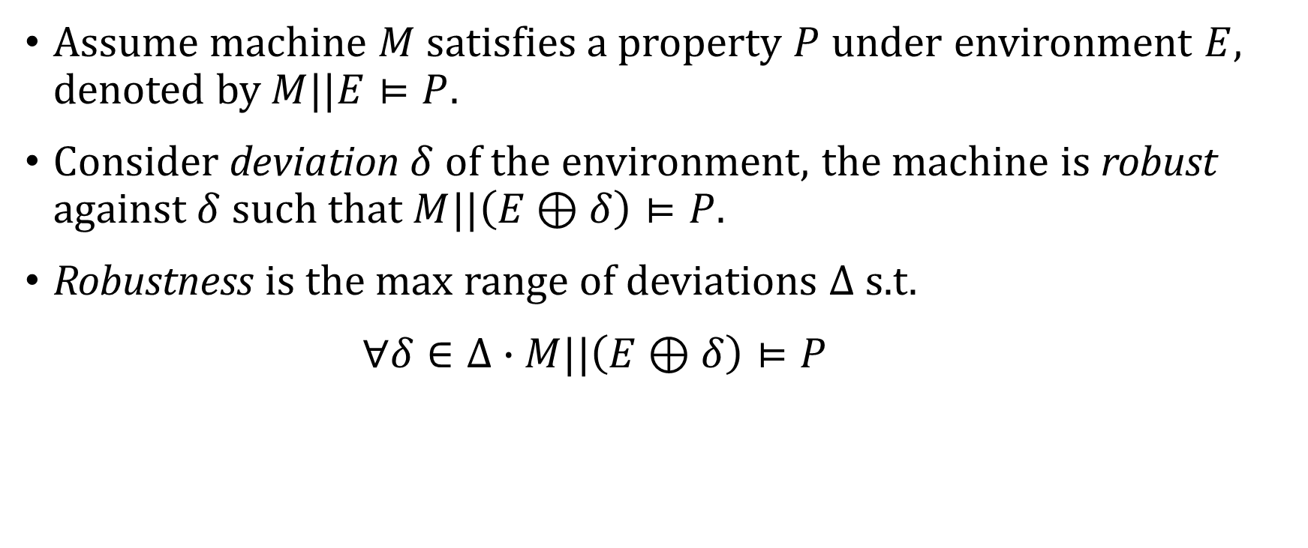
Robustness in a Formal View
Assume machine $M$ satisfies a property $P$ under environment $E$, denoted by $M||E⊨P$.
Consider deviation $δ$ of the environment, the machine is robust against $δ$ such that $M||\left(E⊕δ\right)⊨P$.
Robustness is the max range of deviations $Δ$ s.t.
$∀δ∈Δ∙M||\left(E⊕δ\right)⊨P$

Slide 8
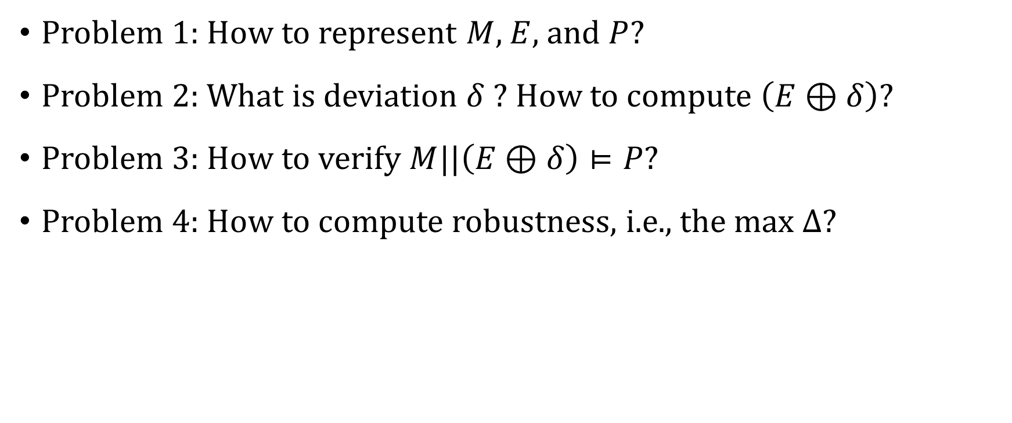
High-Level Research Questions
Problem 1: How to represent $M$, $E$, and $P$?
Problem 2: What is deviation $δ$ ? How to compute $\left(E⊕δ\right)$?
Problem 3: How to verify $M||\left(E⊕δ\right)⊨P$?
Problem 4: How to compute robustness, i.e., the max $Δ$?

Slide 9
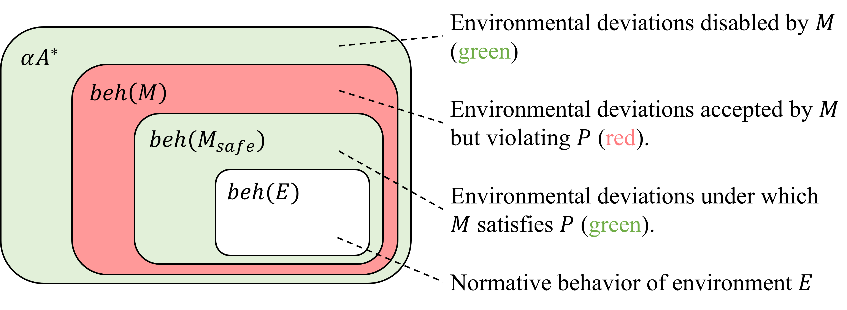

Robustness for Discrete Transition Systems
$M$ and $E$ are modeled in labeled transition systems (LTS).
$P$ is a safety property in LTS.
$δ$ is a set of traces.
$Δ$ is the maximum set of traces s.t. $P$ is still satisfied.
A behavioral notion of robustness for software systems. Changjian Zhang, David Garlan, and Eunsuk Kang. (ESEC/FSE 2020).

Slide 10
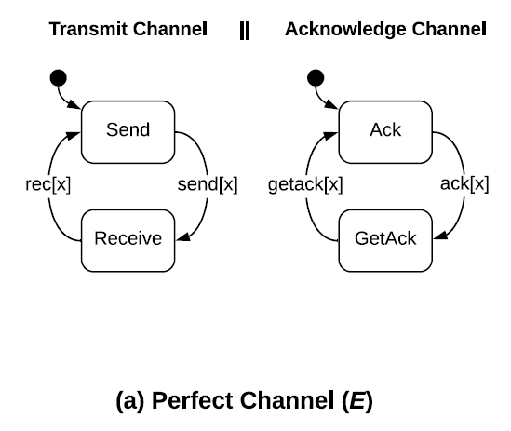
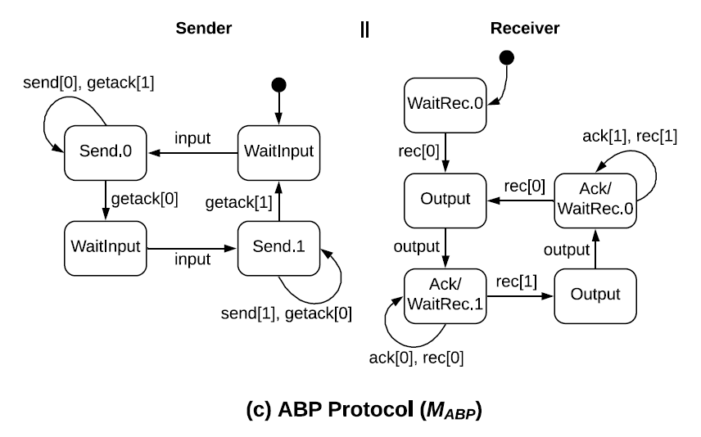
Robustness in LTS
$$Δ=\{\left\langle send\left[1\right], rec\left[0\right]…\right\rangle ,\left\langle send\left[1\right], rec\left[1\right],ack\left[1\right],getack\left[0\right],…\right\rangle ,…\}$$

Slide 11
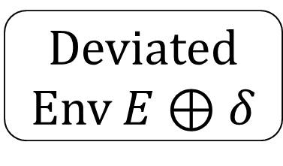
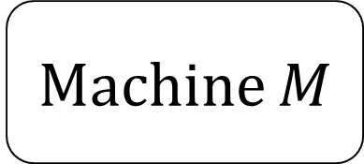

Robustification of Systems in LTS with Supervisory Control
Machine $M$
Deviated Env $E⊕δ$
$$⊭P$$

Slide 12
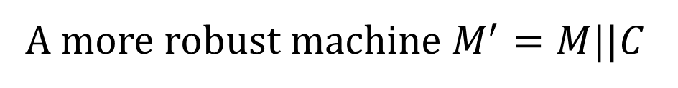
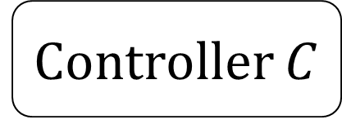

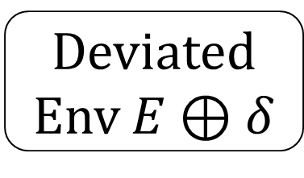

Robustification of Systems in LTS with Supervisory Control
Controller $C$
Ensure property is satisfied by disabling actions.
Observe events in the machine and environment.
$$⊨P$$
Machine $M$
Deviated Env $E⊕δ$
A more robust machine $M^{′}=M||C$
Robustification of Behavioral Designs against Environmental Deviations. Changjian Zhang, Tarang Saluja, Romulo Meira Goes, Matthew Bolton, David Garlan, and Eunsuk Kang. (ICSE 2023).

Slide 13
Ongoing & Future Work
Robustness computation for a decomposed system.
Architecture tactics for robustness (in formal presentation).
Robustness for Cyber-Physical Systems (CPS).
Robustness for systems with ML.

Slide 14
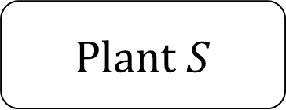
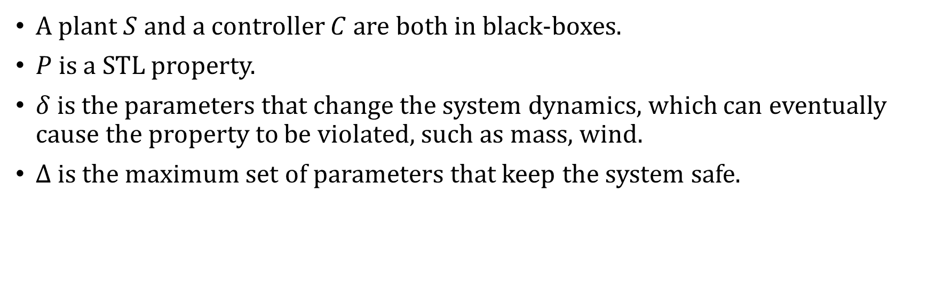
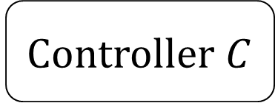
Robustness for CPS
Drones, autonomous vehicles, power grid …
Plant $S$
Controller $C$
PID, MPC, RL controllers
A plant $S$ and a controller $C$ are both in black-boxes.
$P$ is a STL property.
$δ$ is the parameters that change the system dynamics, which can eventually cause the property to be violated, such as mass, wind.
$Δ$ is the maximum set of parameters that keep the system safe.

Slide 15
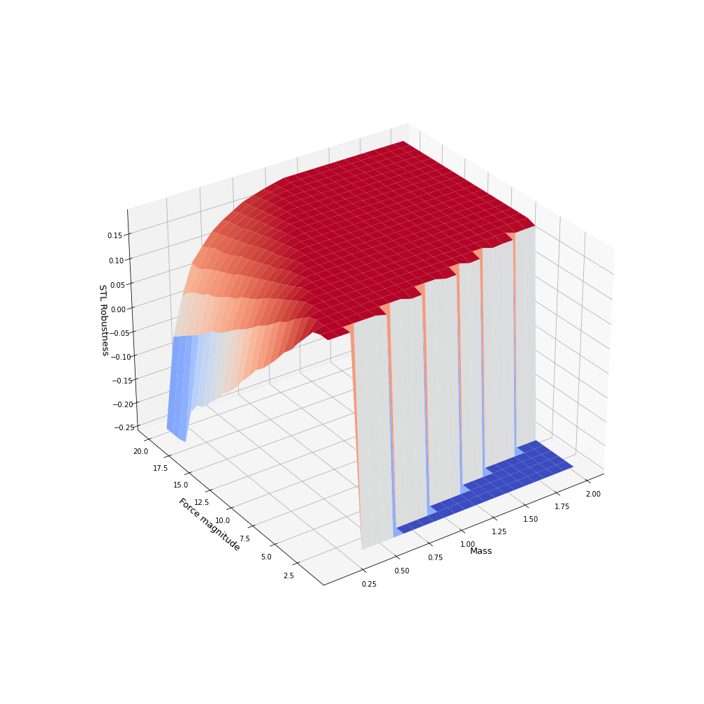
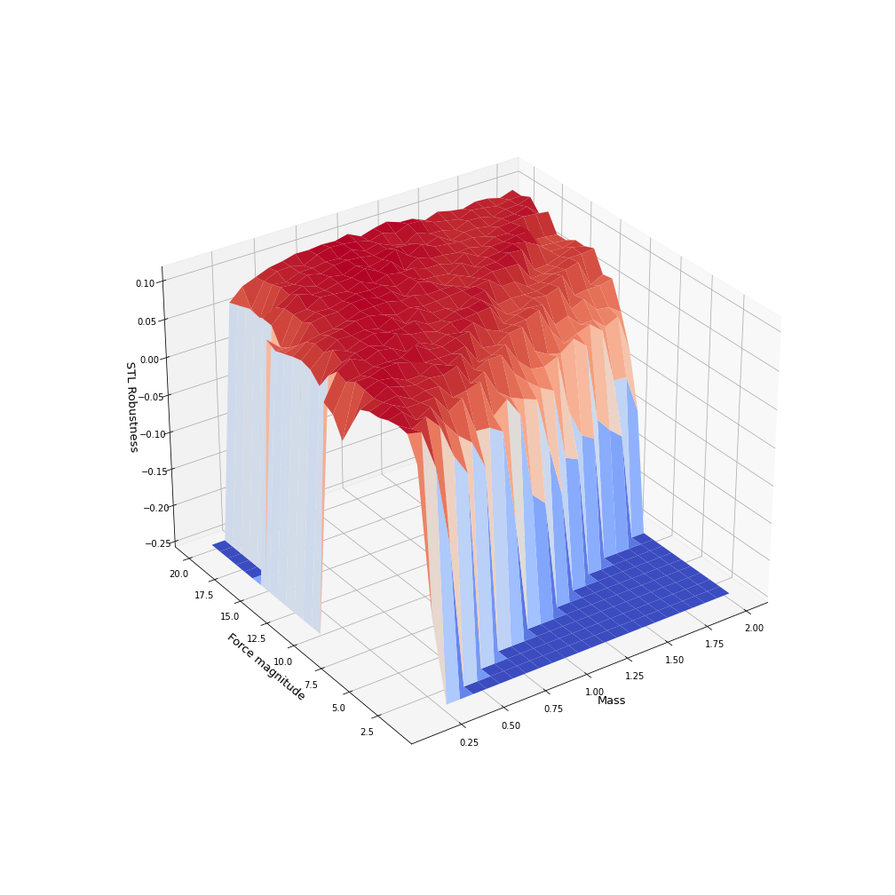
Robustness for CPS
(a) PID
(b) DQN

Slide 16
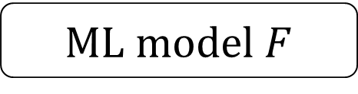
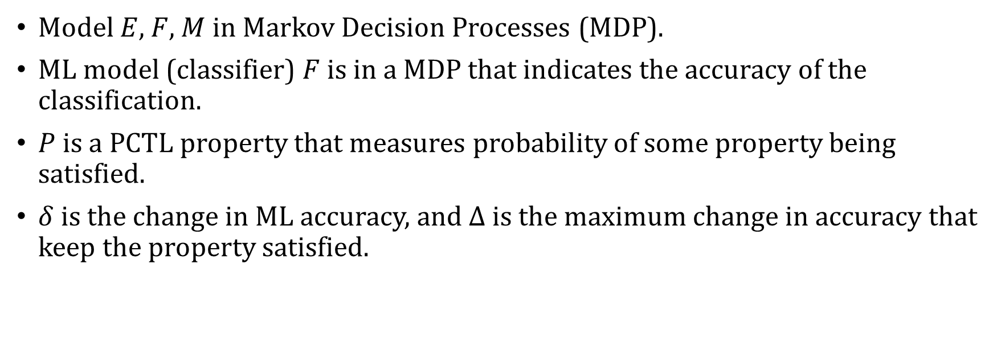
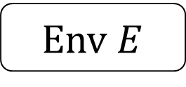
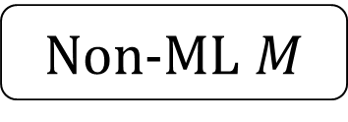
Robustness for Systems with ML
Env $E$
ML model $F$
Non-ML $M$
Model $E$, $F$, $M$ in Markov Decision Processes (MDP).
ML model (classifier) $F$ is in a MDP that indicates the accuracy of the classification.
$P$ is a PCTL property that measures probability of some property being satisfied.
$δ$ is the change in ML accuracy, and $Δ$ is the maximum change in accuracy that keep the property satisfied.

Slide 17
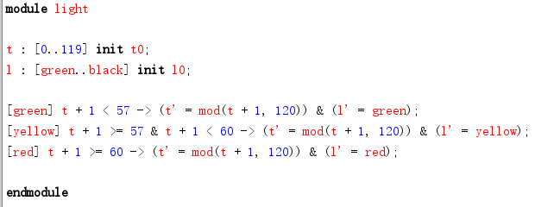
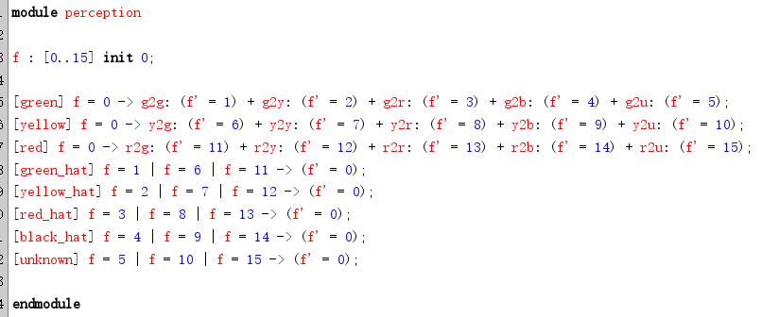
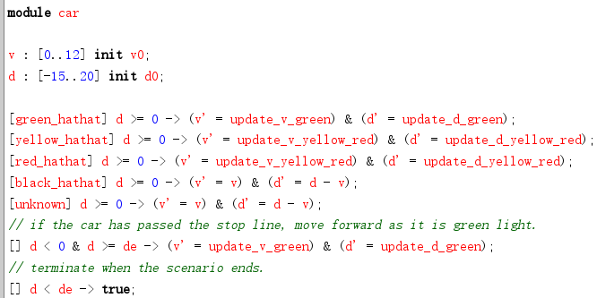
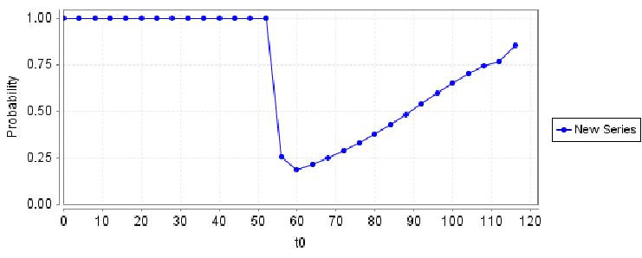
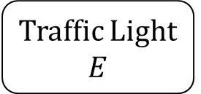

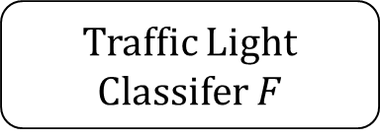
Robustness for System with ML Perception
Traffic Light $E$
Traffic Light Classifer $F$
Vehicle Control $M$

Slide 18



AlloyMax: Bringing Maximum Satisfaction to Relational Specifications
Changjian (CJ) Zhang, Ryan Wagner, Pedro Orvalho
David Garlan, Vasco Manquinho, Ruben Martins, Eunsuk Kang
Notes:
Hello everyone, my name is CJ. In this talk, I’ll briefly introduce our work AlloyMax: Bringing Maximum Satisfaction to Relational Specifications. This a joint work of researchers from Carnegie Mellon University and Institute of Systems and Computers Engineering in Lisbon.

Slide 19
What is Alloy?
Alloy: a first-order relational logic modeling language and analyzer.
Use cases:
Design Analysis: assert the behaviors of a system satisfy some property.
Model generation: generate a model satisfying some constraints.
Workflow:
Spec $S$ in FOL
Spec 𝑆 in FOL
SAT Problem
A model $M⊨S$
A model 𝑀⊨𝑆
Notes:
Alloy is a modeling language based on first-order relational logic. With its model analyzer, a FOL problem is translated into a Boolean Satisfiability problem and is solved by an off-the-shelf SAT solver. It is widely used in:
First, design analysis, for example, we can use Alloy to model the behavior of a system, and then verify that certain properties are satisfied.
Second, model generation: for example, we can use Alloy to generate a model that satisfies some given constraints.

Slide 20
Example: Course Scheduling
A course scheduling system:
Each student must take at least 3 courses;
Each student must take all their core courses;
A student must not take courses whose lecture times conflict.
Notes:
Let’s go through an example! Suppose we are building a course scheduling system where:
First, Each student must take at least 3 courses, and Second, each student must take all their core courses, finally, a student must not take courses whose lecture times conflict.

Slide 21

An arbitrary valid solution
 | Mon | Tue | Wed | Thu | Fri
AM | CS101 | ML/Compiler | CS101 | ML/Compiler
PM | SE | OS | SE | OS | CS101
Alloy:
run {
validSchedule[courses]
}
Core course: CS101
Alice
Predicate for the 3 requirements
Notes:
Now, suppose the CS department of CMU is offering 5 courses. And we have a student Alice who must take CS101 as a core course. We can use Alloy to generate a valid but arbitrary solution, i.e., the predicate which defines the three requirements should be true.

Slide 22
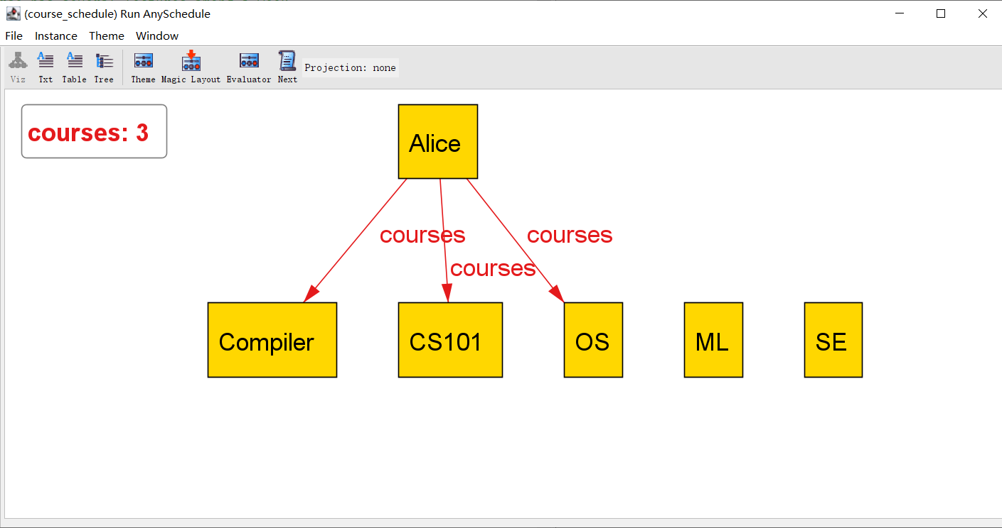
An arbitrary valid solution
 | Mon | Tue | Wed | Thu | Fri
AM | CS101 | ML/Compiler | CS101 | ML/Compiler
PM | SE | OS | SE | OS | CS101
Alloy:
run {
validSchedule[courses]
}
Core course: CS101
Alice
Predicate for the 3 requirements
Notes:
By running the analyzer, it returns a solution that Alice could take CS101, Compiler, and OS. And here’s a screenshot from Alloy.

Slide 23
Maximizing students’ interests
 | Mon | Tue | Wed | Thu | Fri
AM | CS101 | ML/Compiler | CS101 | ML/Compiler
PM | SE | OS | SE | OS | CS101
Alloy:
Interests: ML and SE
Alloy cannot solve this optimization problem!
Alice
Notes:
Then, suppose we also model the personal course preferences into the system, and Alice is interested in ML and SE. We expect the system to generate a solution that satisfies the course requirements and also maximizes students’ interests.
This becomes an optimization problem, that is we want to maximize the number of registered courses that a student is interested in. However, Alloy cannot solve such an optimization problem.

Slide 24
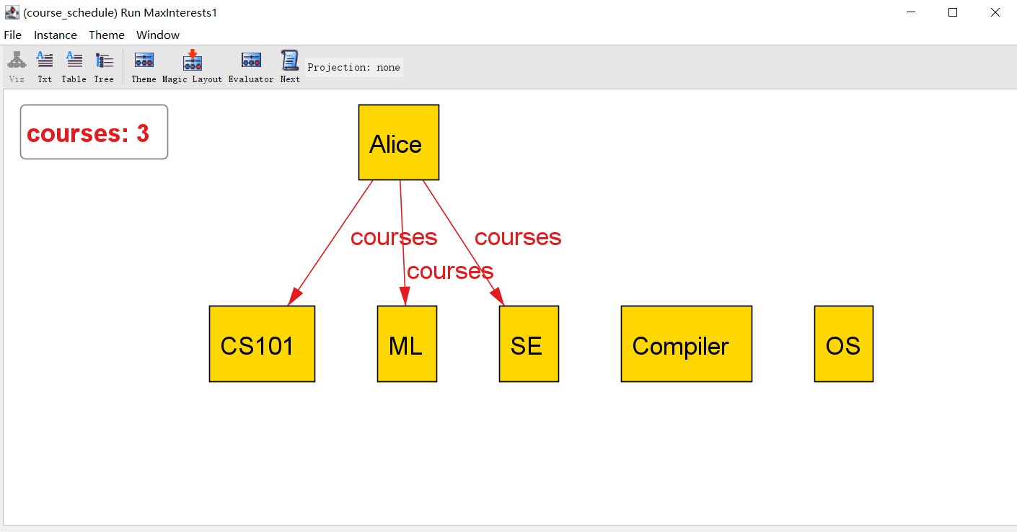
Maximizing students’ interests
 | Mon | Tue | Wed | Thu | Fri
AM | CS101 | ML/Compiler | CS101 | ML/Compiler
PM | SE | OS | SE | OS | CS101
Our extension:
run {
validSchedule[courses]
all s: Student | maxsome s.interests & s.courses
}
Interests: ML and SE
Alice
Maximizing the interests!
Notes:
In our extension, we can solve this problem by adding a new expression, i.e., for any student, there should be some courses that the student is interested in are registered. Moreover, we introduce the new keyword maxsome indicating that it should maximize these courses for each student. By solving this problem, our extension returns a solution where both ML and SE are registered. Here’s the screenshot from our extension where ML and SE are registered.

